Slide 1
Capstone Project
Insurance Claims Analytics – End‑to‑End Data
Engineering Pipeline
Sarita Subedi
Subedi.sarita2021@gmail.com

Slide 2
Problem
Raw insurance data scattered in CSV files on S3.
Manual analysis, no single source of truth.
Difficult to answer key questions:
Which diseases drive the most claims and cost?
Which groups/subgroups and hospitals are most utilized?
How many claims are rejected and why?

Slide 3

Objectives & Requirements
Build
Build an end‑to‑end cloud data pipeline for insurance claims analytics.
Standardize
Standardize data into a star schema (fact + dimensions).
Validate
Validate gold data via Athena.
Load
Load curated data into Redshift.
Deliver
Deliver output tables for key business questions (disease, age, profitability, utilization, rejections, etc.).

Slide 4

Technology and Stack
Cloud & Storage
AWS S3 – raw (Bronze), cleaned (Silver), and modeled (Gold) datasets
Data Processing
PySpark – ETL/ELT transformations, joins, type casting, star‑schema creation
Python – orchestration scripts and data preparation
Query & Metadata Layer
AWS Glue Data Catalog – table/metadata definitions for Athena
Amazon Athena – external tables and ad‑hoc SQL validation on Gold Parquet
Data Warehouse
Amazon Redshift – project_model (fact/dim tables) and project_output (use‑case tables)
Redshift Spectrum / COPY with FORMAT AS PARQUET for loading from S3
Development & Tools
PyCharm / local IDE – PySpark development
SQL clients / Redshift query editor – DDL, CTAS, and analytical queries

Slide 5
Input Datasets
Patients (demographics, birth date, city)
Subscribers (policy details, subgroup, eligibility)
Disease (disease ID/name, subgroup mapping)
Groups & Subgroups (policy groups, premiums)
Hospitals (hospital metadata)
Claims (claim type, amount, status, dates)

Slide 6
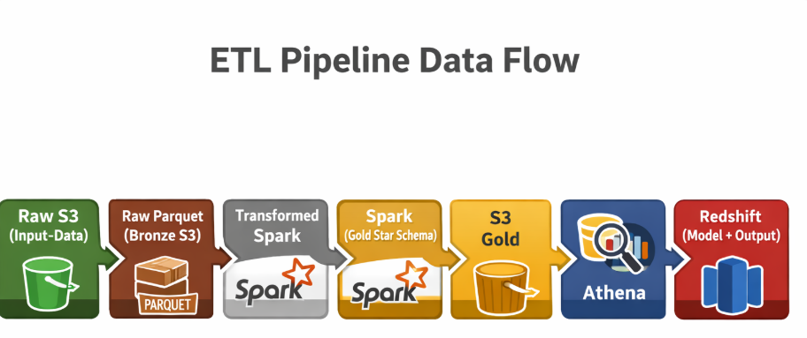
Solution Architecture (High‑Level)

Slide 7
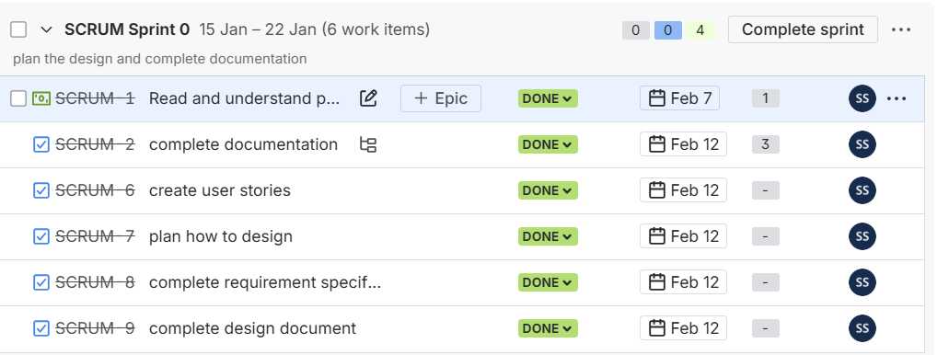
Jira sprints and user stories

Slide 8
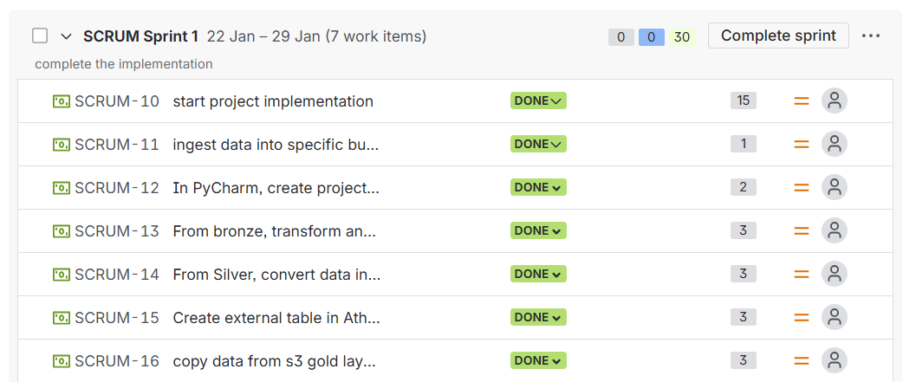
Sprint-1

Slide 9
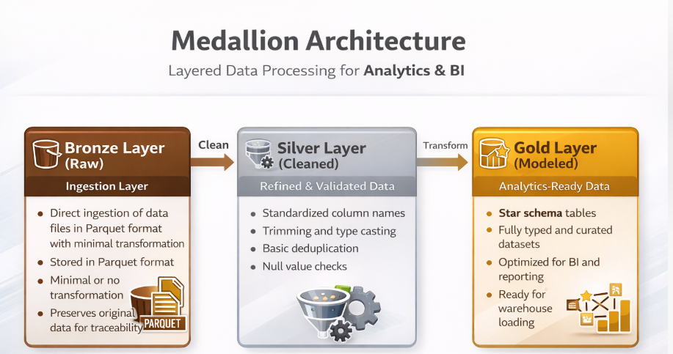

Slide 10
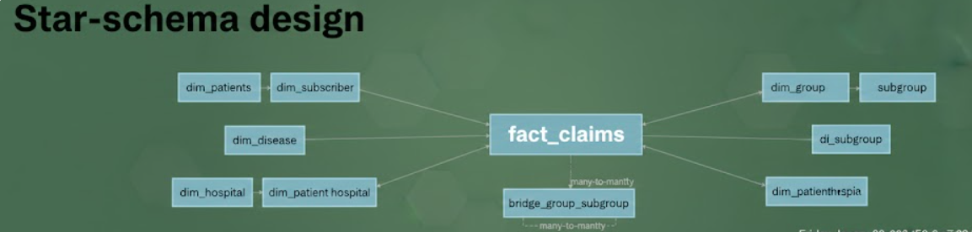

Slide 11

steps
Raw Data Upload
CSVs → S3 Bronze.
Silver Transformation (PySpark)
Read from Bronze → clean & cast → write Parquet to Silver.
Gold Modeling (PySpark)
Join silver tables → build fact_claims & dims → write Parquet to Gold.
Athena Validation
Create external tables → run SELECT * LIMIT 10 checks.
Redshift Load
Create project_model schema → create tables → COPY ... FORMAT AS PARQUET.
Analytics Outputs
CREATE TABLE project_output.... AS SELECT ... for each requirement.

Slide 12
Redshift – project_model Schema
Tables:
Fact table: fact_claims (central fact).
Dimension table: dim_subscriber, dim_patients, dim_disease, dim_group, dim_subgroup, dim_hospital, dim_patient_hospital, bridge_group_subgroup.
Loaded data using:
COPY project_model.fact_claims
FROM 's3://capstoneproj-sarita/gold/fact_claims/'
IAM_ROLE 'arn:aws:iam::<account-id>:role/redshiftAdmin’
FORMAT AS PARQUET;

Slide 13
Redshift Output Schema & Use Cases
Created CTAS tables for each business requirement:
Disease with maximum number of claims.
Subscribers aged < 30 with any subgroup.
Group with maximum subgroups.
Hospital serving most patients.
Most subscribed subgroup.
Total number of rejected claims.
City with most claims.
………….

Slide 14
Business use cases table example
--Disease with maximum number of claims
CREATE TABLE project_output.max_claims_by_disease AS
SELECT
d.disease_id,
d.disease_name,
COUNT(*) AS total_claims
FROM project_model.fact_claims f
JOIN project_model.dim_disease d
ON f.disease_id = d.disease_id
GROUP BY d.disease_id, d.disease_name
ORDER BY total_claims DESC
LIMIT 10;

Slide 15
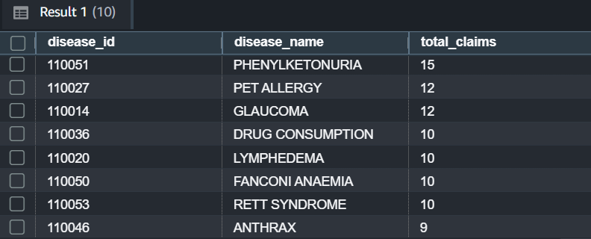
Disease with maximum number of claims

Slide 16
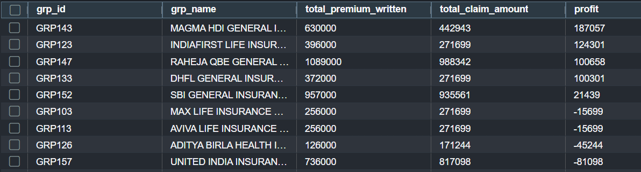
Most Profitable Group

Slide 17
Challenges and Lesson Learned
Schema and Mismatch in parquet file and Redshift table
EDA – exploratory data analysis
Finalize the table schema and data type beforehand
Be consistent through

Slide 18
Thank you !

